Slide 1

Introduction

Slide 2
TOMP API - context
The TOMP API is an abbreviation for TO – MP API (Transport Operator to MaaS Provider)
The first versions are initiated by de Dutch government (Ministry of I&W – infrastructure and water)
The government facilitated 7 MaaS pilots in the Netherlands and proactively created discussion groups and working groups to facilitate in:
Standardization (TOMP is a result of this one)
Eco system
Provisioning of IDs
Learning environment
More context items:
Transaction processor
Nation Access Point

Slide 3
TOMP API - modules
Planning
Booking
Trip execution
Support
Payment
Operator Information

Slide 4
Planning
Multiple scenario’s for planning:
I want an asset or trip now or in the (near) future
All kinds of aspects:
Map based (this asset)
Location based
Bluetooth swipe based
Reserve an asset type
Reserve a specific asset
Chained legs (multimodal)
Requiring user specific information

Slide 5
Booking
Transactional commit
Facilitating in providing requested user specific information
Postponed commit

Slide 6
Trip execution
Look for available assets near starting point
Event based
Prepare (f.i. requiring access codes/QR/deep links or just to send a signal that the taxi is driving to the pickup address)
Assign_asset: in case a type is reserved and it’s needed to assign a specific asset (can also be done implicitly in prepare or set_in_use)
Set_in_use: the actual start of the leg
Pause
Finish
Start_finishing
Issue

Slide 7
Support
Reporting problems and handling them (communication between TO and MP)

Slide 8
Payment
Reporting the ‘journal entries’ that contain the
Fares for executed legs
Extra costs per leg (fines, no show costs etc)
(Direct) report of extra costs, to inform other side, real-time instead of waiting for a request of journal entries.

Slide 9
Operator information
GBFS like
Static information about TO, stations, operating area’s, opening hours, etc
(Near) real time information about the assets

Slide 10
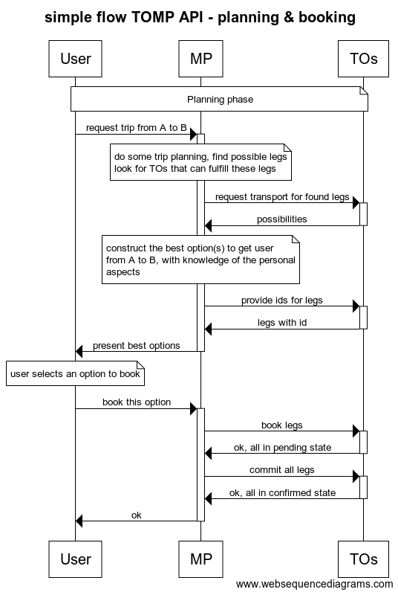
Simple sequence diagram

